Slide 1
Dashboard With Plotly
Joanne Gates, Sumitha Prabhu, John A Kelly and Zeray Admasu

Slide 2
Dashboard is a very useful data visualization tool. Currently, it is being used in different sectors.
Finance
Hospitality
Engineering
Health and so on.
We covered subjects we covered in class except Blockchain and smart contract
Pandas
Data Visualization
Deep learning
NLP
API integration

Slide 3
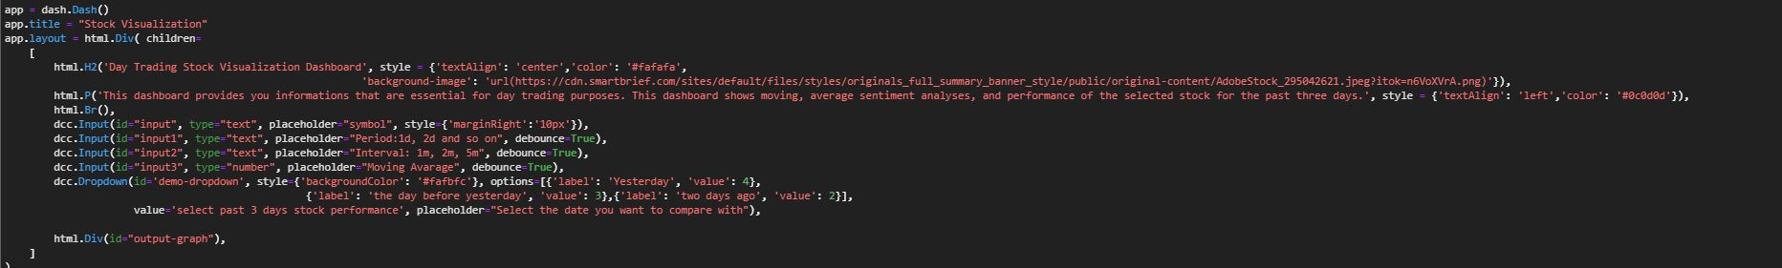
Components of Dashboard
It has four inputs, accepts text and numbers.
(Symbol, period, Interval and Moving Average)
Symbol - ticker of the stock
Period - how many days of stock data ( format, 1d , 2d , 3d , 1wk , 1mo)
Interval -
Moving Average -
One dropdown.
(Past selected stock performance)
All Inputs are controlled.
Notes:
Zeray

Slide 4
The Main Dashboard
The purpose of the Dashboard we created is to increase confidence when day and swing trading.
It presents:
Current price of stocks that are available on yahoo finance.
Sentiment analysis for any stock by web scraping
Controlled Moving Average
Performance of selected stock for the past three days.
Having the above four informations at the same time will increase the confidence when buying and selling stocks.

Slide 5
Trend indicator based on sentiment analysis
First do the sentiment analysis for the news headlines using BeatutifulSoup and NLTK Vader sentiment analysis libraries.
We use Yfinance to obtain the stock prices
Next we create the charts using Plotly Express
These charts are then displayed in the interactive DASH app which talks to the python code and updates the charts
Notes:
Sumitha

Slide 6
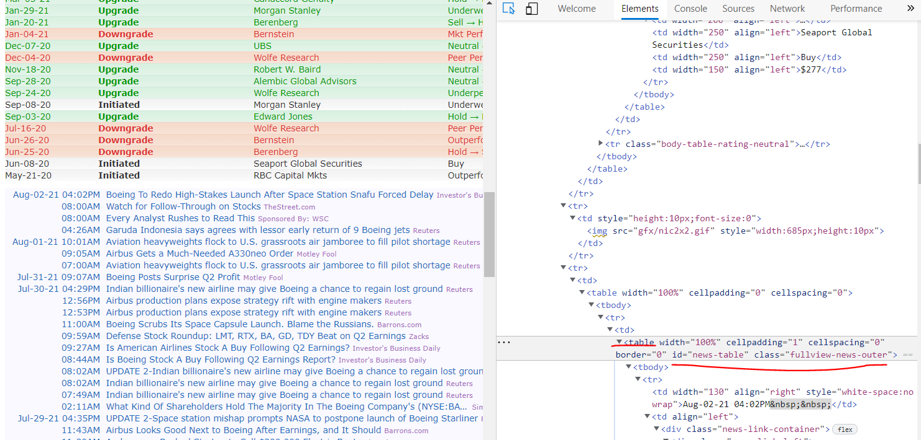
Sentiment Analysis - News Headlines
BeautifulSoup Library
BeautifulSoup library is used for web scraping the news from the news table from the website.
Using inspect on the webpage we can locate table-id which is then used to scrape tr (tablerow).
News headlines are then converted into a dataframe which is used for sentiment analysis
Notes:
Sumitha

Slide 7
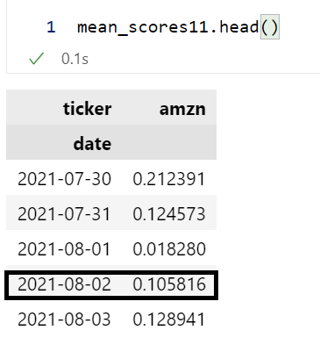
Sentiment Analysis - NLP
NLTK Vader Library
This is used to find neutral, positive, negative and compound sentiment for each headline.
Compound values are then aggregated date-wise to get mean scores

Slide 8
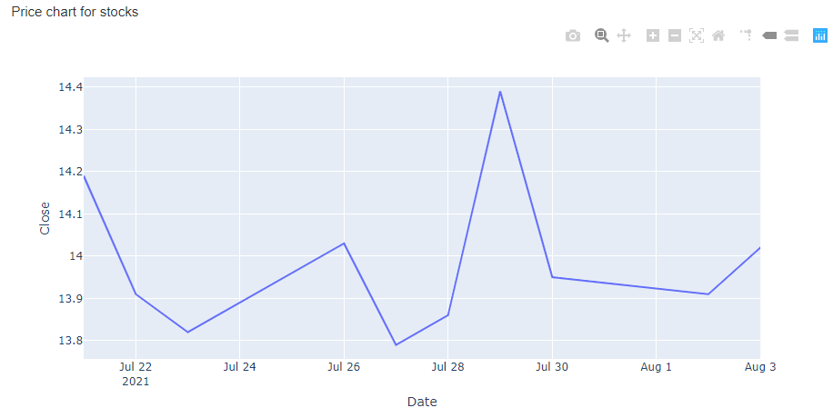
Sentiment Analysis - Price Charts
YFinance Library
This is used to obtain the stock prices for ticker and S&P 500, NASDAQ and DOW30 index closing values
Period is 2wk period
Sentiment score for t0 is seen in the price movement of t1

Slide 9
Dash Plotly Express Library
Plotly Express is used to create charts for sentiment analysis , stock prices.
Dash app is used to create a web page which displays charts on a web page.
User can interacts with the chart and DashApp interacts with the python code in the backend and displays updated chart
Notes:
Sumitha

Slide 10
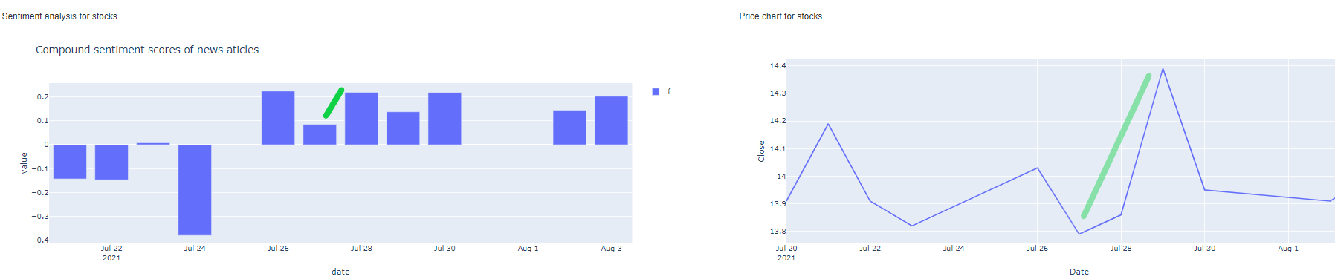
Dashboard Sentiment of news-headlines

Slide 11
Sentiment Analysis - Social Media
tweepy Library (twee-py)
Tweepy is used to scrape raw twitter data from user timelines or #hashtags using the official Twitter API. Score twitter sentiment polarity.
Limitation: requires a Twitter developer account approval to get the API keys. Then you need to create an access token to attach to tweepy API object.
Limitation: rate-limits. Only get 500,000 tweets per day, only get 5-7 days worth of current tweets. For @users like elonmusk, you can only get 20 tweets. Authorization fails frequently causing need to regenerate your Twitter API keys.
Limitation: too much cleanup to get sentiment from tweets. People type emojis, videos, pictures, and other data-types. Al
Limitation: too many re-tweets, promotions, ads, and quote-tweets. We wanted tweets from authors.
Notes:
Fundamentals are gone from investing they say. We wanted to have comparative sentiment analysis on a financial topic between news sources and social media. This is because most finance actions and buzz comes from forums like reddit or Twitter. We chose Twitter for our social

Slide 12
Why not use just news for sentiment analysis?
We wanted to have real-time stock price info called on the dashboard, and we also wanted real-time sentiment analysis of those stocks parallel to the displayed price.
We wanted to have comparative sentiment analysis: what news is saying, and what social media is saying.
People are making financial decisions based on FOMO driven by sites like reddit, Discord, and Twitter more than what is reported in the media.
Not every stock is talked about on social media. Only meme stocks or crypto. That makes real-time sentiment analysis complicated.
Too much cleanup needed and you cannot simply scrape the data without constant authorization. At best, we can get snapshots.
News is much easier to scrape and is plain text. Less code needed.
Notes:
r/wallstreetbets is slowly losing ground to rising subreddit r/Superstonks. Hedge funds and financial firms are infiltrating the subreddit to plug their products which was against the forums rules.

Slide 13
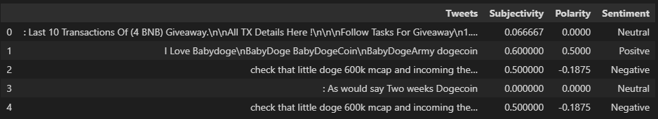
Scrape 1000 tweets, clean-up dubious elements, break down the tweet into subjectivity, polarity, and sentiment label

Slide 14
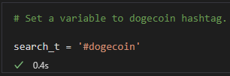
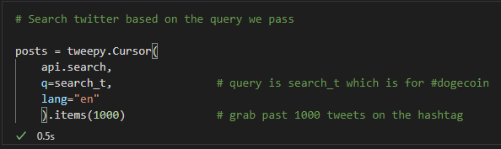
Define a search term and call on a tweepy Cursor to do an API search and store data.

Slide 15
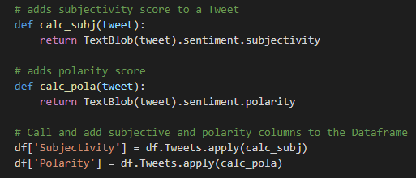
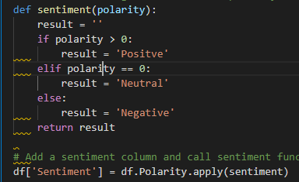
Define functions for subjectivity scores, polarity scores, and polarity labels of each word in a single tweet.
Notes:
Subjectivity - score of 0-1. Determines whether the entirety of a sentence (or a tweet) expresses personal feelings, views or beleifs. 0 is objective. 1 is very subjective.
Polarity - scores based on the positivity, negative tone of the words in the sentence or tweet.
Sentiment - applies labels to the polarity as Positive, Negative, or Neutral.

Slide 16
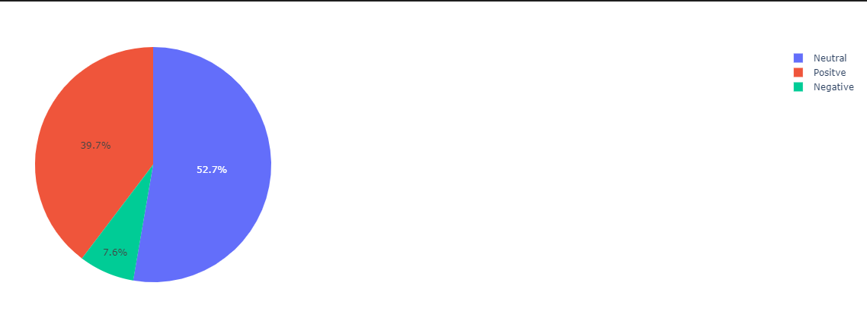
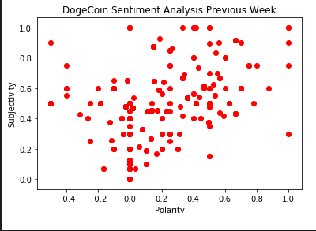
Sentiment Results - Social Media
Notes:
Most people’s sentiment on social media was based on SUBJECTIVITY as opposed to OBJECTIVITY, more neutral and positive as opposed to negative sentiment.

Slide 17
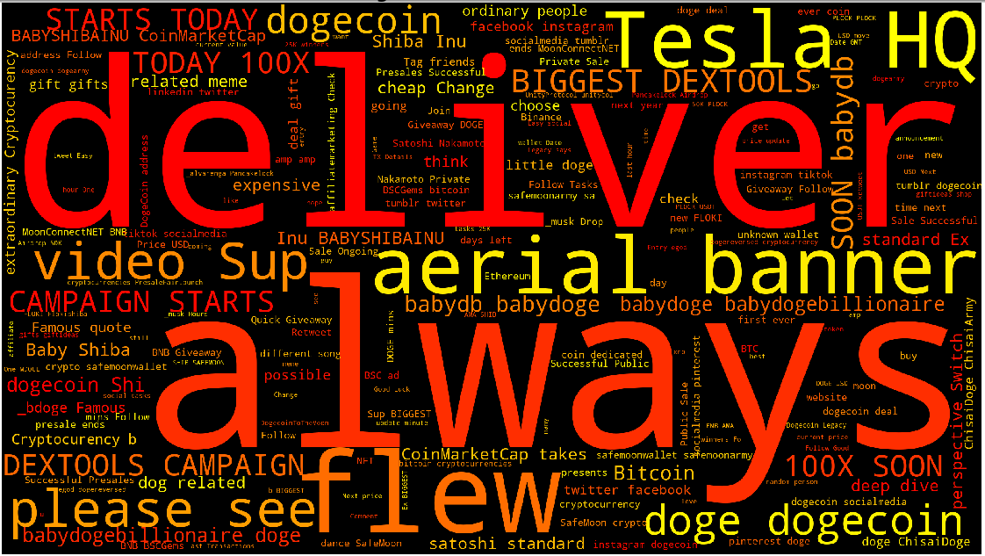

Slide 18
Long Short Term Memory(LSTM)
LSTM an artificial recurrent neural network (RNN) used in the field of deep learning.
LSTM are very good at holding long term memories.
LSTM are widely used for sequence prediction problems and have proven to be extremely effective.
The reason they works so well is because LSTM is able to store past informant that is important, and forget the information that is not.

Slide 19
LSTM model life-cycle in Keras
Define Network : model = sequential;model.add(LSTM(2)), model.add(Dese(1))
Compile Network : model.compile
Fit Network: model.fit(X, y, batchsize,epochs)
Evaluate Network:loss, accuracy = model.evaluate(X,y)
Make predictions : model.predict (X)

Slide 20
LSTM: Graphing Libraries
Matplotlib : is the simplest way to plot data in Python.
Plotly (Plotly express): is more sophisticated data visualization tool to create interactive plot. Plotly express is easy to use, high level interface to plotly.
Dash: is a open source web application framework written in Python for building data visualization interfaces.

Slide 21
Dash installation & packages
Install
The core dash backend pip install dash
Dash front-end pip install dash-renderer
Dash HTML components pip install dash-html-components
Dash core components pip install dash-core-components
Plotly pip install plotly
Packages
Import dash
Import dash_core_componts as dcc
Import dsah_html_components as html

Slide 22
Dash App
A dash app. Is usually composed of two parts.
The first part is the layout and describes how the app will look like. such as graphs, the dropdowns, checkbox, sliders…
The second part describes the interactivity of the the application.
Documentations: https://dash.plotly.com/dash-core-components

Slide 23
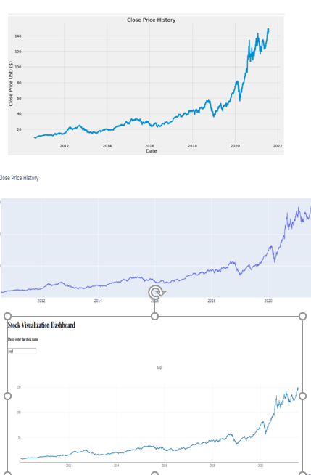
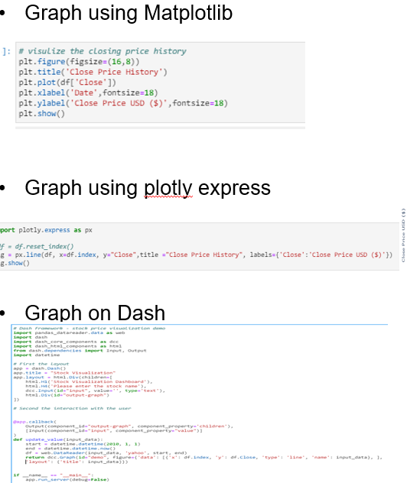
LSTM: Apple stock over 10 years

Slide 24
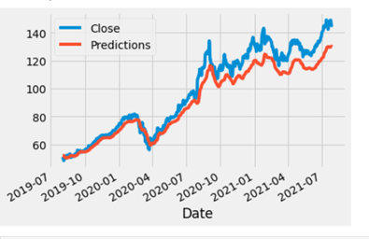

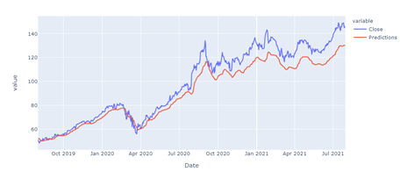

LSTM: Real closing price vs. predicted price
Graph using Matplotlib
Graph using plotly express

Slide 25
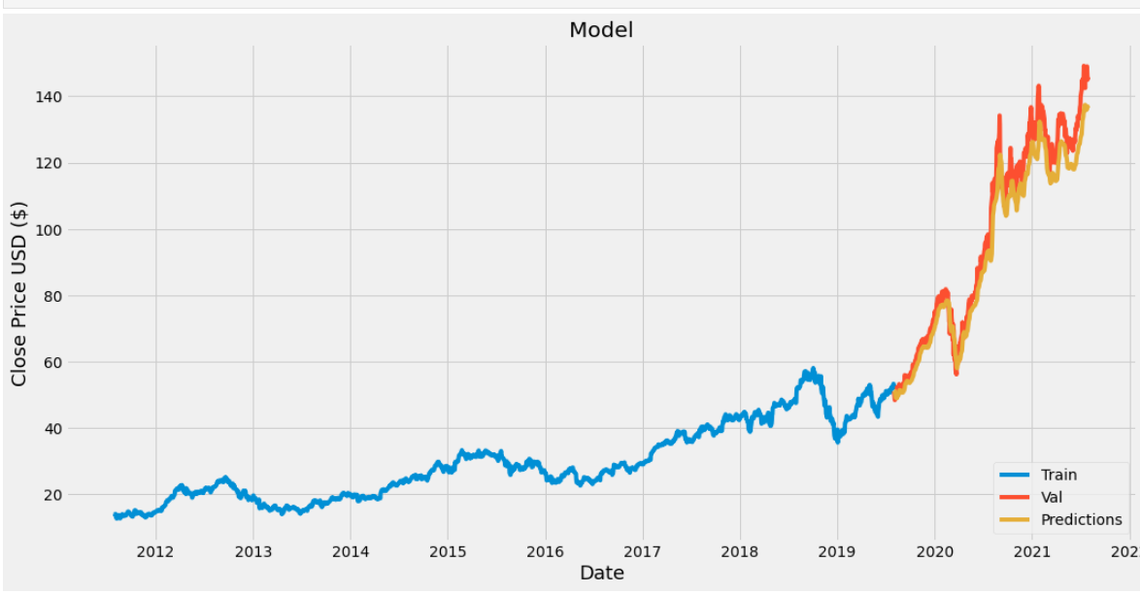
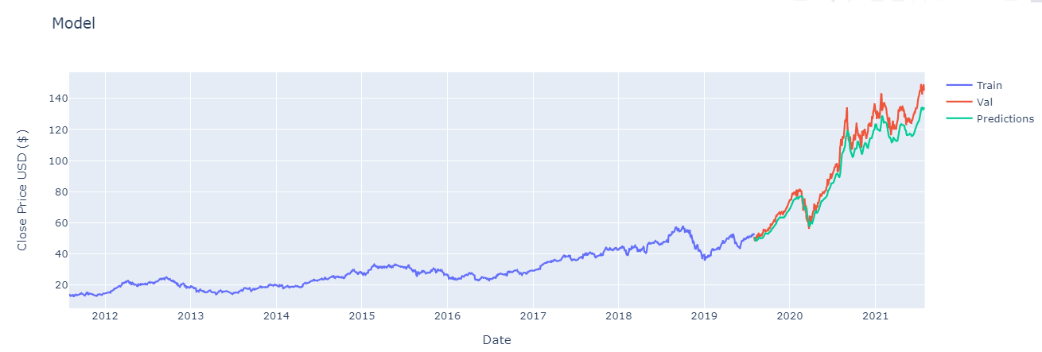
LSTM:Apple stock: training (train) real (valid) and predicted (predictions)
Graphing using matplotlib
plt.show()
Graphing using plotly express
fig.show()

Slide 26
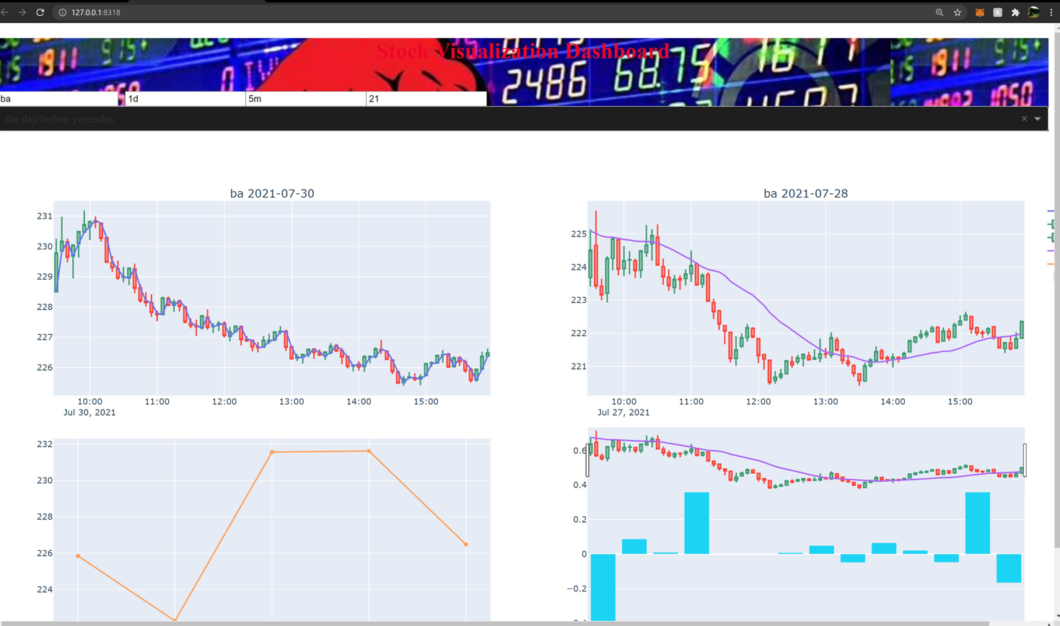

Slide 27
Questions?

